Slide 1
HyDE for semantic search over consumer complaints
CS410 TECHNOLOGY REVIEW · CCDB SEARCH
How Hypothetical Document Embeddings work, and how they compare with other semantic search methods
Carson Wilkins · November 2026
Notes:
(About 30 seconds.) Hi, I’m Carson Wilkins. This is my CS410 technology review. It’s about a semantic search method called HyDE, short for Hypothetical Document Embeddings, and how I plan to use it in my project, CCDB Search: a search engine over the CFPB Consumer Complaint Database. The talk has two parts. First I explain how HyDE works and show what it actually does inside the vector space. Then I compare it with the other main semantic search methods on four public benchmark collections.

Slide 2
Complaint search is a vocabulary-mismatch problem
THE PROBLEM
What a user types
What a matching complaint says (illustrative)
“charged twice for an overdraft”
“I made one purchase at the store and my bank took two fees out of my checking account for the same transaction. When I called, they refused to refund the second fee…”
Keyword search (BM25) only finds documents that share the query’s words. Semantic search compares meaning as vectors, so the right complaint can be found even when the words differ.
CFPB Consumer Complaint Database: public complaints about credit reporting, debt collection, mortgages, cards and bank accounts
Notes:
(About 50 seconds.) The CFPB Consumer Complaint Database is the Consumer Financial Protection Bureau’s public collection of complaints about financial products: credit reporting, debt collection, mortgages, credit cards, bank accounts. Many complaints include a narrative the consumer wrote in their own words. That’s what CCDB Search will search. The challenge is vocabulary mismatch. A user types something short, like “charged twice for an overdraft”, but the complaint that matches might say “my bank took two fees for the same transaction”, sharing almost none of those words. Keyword search like BM25 only finds documents that share the query’s words. Semantic search turns text into vectors so that texts with the same meaning sit close together even when the wording differs. The example complaint on the right is illustrative, not a real record.

Slide 3
Two parts: understand HyDE, then test it against the field
THIS REVIEW
PART I
PART II
HyDE for CCDB Search
Comparison with other methods
How HyDE works
What the averaged vector does on real data
Design choices for CCDB Search
SPLADE, dense, ColBERTv2, hybrid, rerankers, RankGPT
4 BEIR collections vs. a BM25 baseline
Quality, significance, latency
The CFPB data has no relevance judgments, so four public BEIR collections stand in; FiQA (finance) is the closest
Notes:
(About 40 seconds.) The review has two parts. Part one is about HyDE itself: how it works, what it actually does to the query vector on real data, and what that means for how I build CCDB Search. Part two compares HyDE with the other main families of semantic search: learned sparse retrieval with SPLADE, dense bi-encoders, ColBERTv2 late interaction, hybrid fusion, cross-encoder rerankers and RankGPT, an LLM reranker. They’re all measured against a BM25 baseline on four public BEIR collections. I couldn’t evaluate on the complaint database directly because it has no relevance judgments, so these collections stand in for it. FiQA, financial questions answered by forum posts, is the closest match.

Slide 4

Search with fake answers instead of the question
PART I · HOW HYDE WORKS
LLM writes 8 hypothetical passages
Encoder embeds query + passages
Nearest real documents
Average → one vector
Query q
Looks like a document
Errors don’t matter much
No training, same index
Passages are written in the corpus’s style, so their vectors land among real documents.
Passages may invent facts; they are only encoded, never shown to the user.
The LLM never sees the corpus; search is one ordinary dense lookup.
Gao et al., “Precise Zero-Shot Dense Retrieval without Relevance Labels” (2023) · our setup: gpt-oss-120b, 8 samples, bge-small encoder
Notes:
(About 60 seconds.) Here’s the core idea. A normal dense retriever embeds the query and looks for the nearest document vectors. But a short query and a long document are different kinds of text, so their vectors land in different parts of the space. HyDE changes the question. It asks an LLM to write what an answer might look like: in my setup, eight hypothetical passages per query from gpt-oss-120b. Those passages and the query are embedded with the same encoder and averaged into one vector, and that vector is used for an ordinary nearest-neighbour search. Three things make this attractive. The fake passages are written like real documents, so they land among real documents. They might contain made-up facts, but that barely matters because they’re only used to build a vector and the user never sees them. And it needs no training: the LLM never sees the corpus, and the index is a normal dense index.

Slide 5
Searching with the average is a vote
PART I · WHY AVERAGING WORKS
score(d) = v · f(d) = average of 9 similarities
sim(query, d) + sim(passage 1, d) + … + sim(passage 8, d), divided by 9
Shared topic → 9 votes
Invented detail → 1 vote
Still one search
A document about what all the passages agree on scores high against every one of them.
A detail one passage made up matches only that passage, so it barely moves the ranking.
The mean is computed once, so the search costs the same as plain dense retrieval.
Notes:
(About 50 seconds.) Why does averaging work? The similarity score is linear, so scoring a document against the averaged vector is exactly the same as averaging that document’s similarity to each of the nine vectors: the query plus the eight passages. That makes HyDE a vote. A document about the topic all the passages agree on gets nine votes. A detail that one passage hallucinated only matches that one passage, so it gets one vote and barely moves the ranking. That’s why made-up facts do little harm. And because the mean is computed once, the search itself costs the same as ordinary dense retrieval. All of the extra cost is in the LLM call.

Slide 6
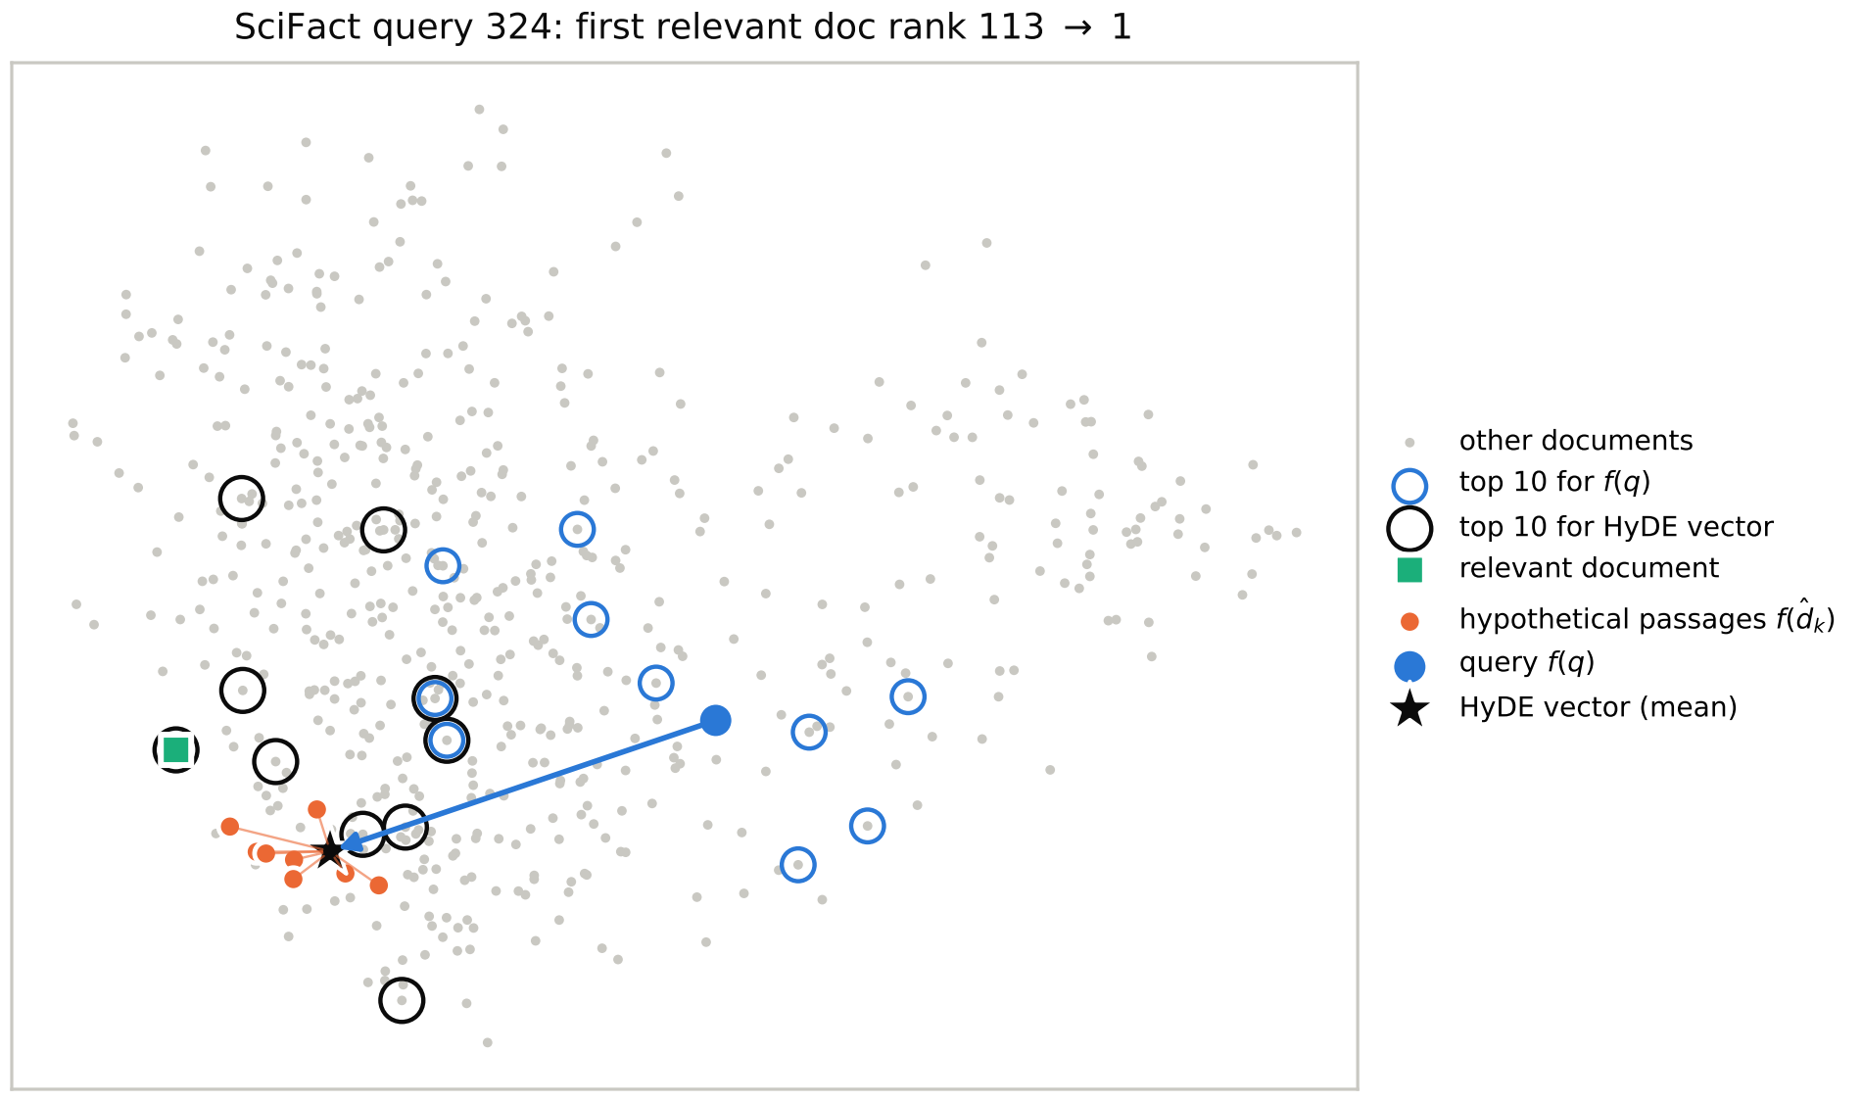

The average lands next to the right document
PART I · A REAL EXAMPLE
SciFact claim: “Deleting Raptor reduces G-CSF levels.”
The relevant abstract never says “Raptor”; it talks about mTOR signalling.
The passages supply the link: “Raptor, a core component of … mTORC1”.
113
1
Rank of the relevant abstract: query vector → HyDE vector
Real bge vectors, 2-D PCA projection. Chosen as the query with the largest gain, so an illustration, not a typical case.
Notes:
(About 60 seconds.) Here’s a real example from the SciFact collection. The claim is “Deleting Raptor reduces G-CSF levels.” The relevant abstract never uses the word Raptor; it talks about mTOR signalling. Searching with the query vector alone ranks that abstract 113th. The passages gpt-oss wrote say things like “Raptor, a core component of mTORC1”. That’s partly invented, since it describes a mouse study that doesn’t exist, but it supplies the missing link from Raptor to mTOR in the vocabulary of an abstract. The plot shows the real vectors projected to two dimensions. The blue dot is the query, and the blue rings are its top 10 results, all in the wrong area. The orange dots are the eight passages, clustered next to the green relevant document. The black star is their average, and its top 10, the black rings, include the relevant document at rank 1. I picked this query because it had the biggest gain, so it’s an illustration, not a typical case.

Slide 7
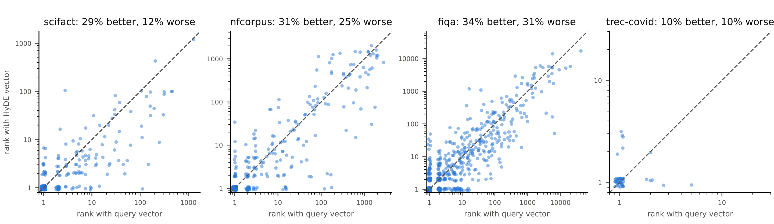
HyDE helps more queries than it hurts, but not all
PART I · ACROSS ALL QUERIES
Closer to relevant docs
8 passages ≈ 1 vector
Mean cosine 0.773 → 0.879 on SciFact, but closer to every document too, so ranks are what count.
Pairwise cosine 0.96: the samples mostly add robustness, not diversity.
Dots below the diagonal = queries HyDE helps (rank of first relevant document, bge, log scales)
Notes:
(About 50 seconds.) That was one query, so here are all of them. Each dot is a query. The x-axis is where the first relevant document ranks with the plain query vector, the y-axis is where it ranks with the HyDE vector, and dots below the diagonal are queries HyDE helped. On SciFact it helps 29 percent of queries and hurts 12 percent. On NFCorpus and FiQA it moves things more in both directions. On TREC-COVID the relevant document is usually already first. Two more findings: the HyDE vector is closer to the relevant documents, but it’s also closer to every document, so what matters is the ranking, not the raw similarity. And the eight passages are almost the same vector, with a pairwise cosine of 0.96. So the extra samples add stability, not much diversity, which suggests fewer samples might do nearly as well.

Slide 8
With an unnormalized encoder, long passages drown out the query
PART I · WHEN HYDE BREAKS
1.35 vs 2.0
11 → 430
0.556
Contriever vector length: query vs. the long gpt-oss passages. Longer arrows pull the average harder.
Median rank of the first relevant FiQA document, query vs. HyDE-Contriever.
HyDE-Contriever nDCG@10 on SciFact: below Contriever alone (0.649) and the paper’s 0.691.
Lesson: HyDE works when the passages look like the corpus and every vector gets an equal say. With normalized bge vectors, the same passages work well.
Notes:
(About 50 seconds.) HyDE also failed in an instructive way. The original paper uses the Contriever encoder, and with gpt-oss passages that setup didn’t reproduce: on SciFact it scored 0.556, below Contriever on its own and below the paper’s 0.691. The cause is vector length. Contriever doesn’t normalize its vectors, and gpt-oss wrote long, markdown-heavy passages of 400 to 500 words, whose vectors are much longer than the query’s, about 2.0 versus 1.35. In an average, longer arrows pull harder, so the question itself gets drowned out. On FiQA, the median rank of the first relevant document fell from 11 to 430. With the normalized bge encoder, every vector has length one and gets an equal say, and the same passages work well. So the lesson for my project is: use a normalized encoder, and make the passages look like the documents you’re searching.

Slide 9

HyDE over CFPB complaint narratives
CCDB SEARCH · PLANNED PIPELINE
OFFLINE, ONCE
CFPB complaint narratives
bge encoder (normalized)
Vector index
ONLINE, PER QUERY
User query
LLM writes complaint-style narratives
Embed + average with query
Nearest complaints in index
While the LLM runs, show plain dense results for the query first, then replace them with the HyDE results.
Notes:
(About 45 seconds.) Here’s how this turns into CCDB Search. Offline, once: the complaint narratives are embedded with a normalized encoder like bge and stored in a vector index. Online, for each query, the LLM writes a few narratives in the style of a consumer complaint, those and the query are embedded and averaged, and the index returns the nearest real complaints. Because the LLM step takes seconds, the interface can show plain dense results for the query immediately and swap in the HyDE results when they arrive. The narratives never go to the LLM; only the user’s query does.

Slide 10
Six rules from the measurements
CCDB SEARCH · DESIGN CHOICES
1. Normalized encoder
2. Keep the query in
3. Prompt for narratives
Unit vectors give the query and each passage an equal say.
f(q) anchors the vector to what was actually asked.
Ask for a first-person complaint to the CFPB, plain text, typical length.
4. Try 2–4 samples
5. Plan for latency
6. Hedge and evaluate
The 8 passages were nearly identical (cosine 0.96).
10–19 s per query here: faster LLM, caching, dense results first.
10–31% of queries got worse: fuse with dense or BM25, test on judged CCDB queries.
FiQA, the closest collection to the CCDB, gained only +0.007 nDCG@10 over dense, so narrative style likely matters more than domain
Notes:
(About 60 seconds.) The measurements give six design rules. One: use a normalized encoder. Two: keep the query in the average, because it anchors the vector to what was asked. Three: write the prompt for this corpus. The paper’s prompts ask for a scientific paper or a financial article, and for CCDB Search the prompt should ask for a first-person complaint to the CFPB, in plain text, about the length of a real narrative. Four: try fewer samples. The eight passages were nearly identical, so two to four may give most of the benefit at lower cost. Five: plan for latency. HyDE took 10 to 19 seconds per query here, so I’ll need a faster generator, caching, or showing dense results first. Six: hedge and evaluate. Between 10 and 31 percent of queries got worse, so fusing HyDE with dense or BM25 results is a cheap safety net, and I need a small set of judged complaint queries before relying on it. One caution: on FiQA, the most similar collection, HyDE beat dense by only 0.007, so matching the narrative style probably matters more than being in the finance domain.

Slide 11
Every semantic method beats BM25 somewhere; HyDE leads first-stage retrieval
PART II · RESULTS
nDCG@10 | SciFact | NFCorpus | FiQA | TREC-COVID
BM25 (baseline) | 0.679 | 0.318 | 0.253 | 0.609
SPLADE (learned sparse) | 0.693 | 0.334 | 0.336 | 0.710
ColBERTv2 (late interaction) | 0.691 | 0.339 | 0.355 | 0.731
Dense (bge-small) | 0.713 | 0.343 | 0.403 | 0.757
Hybrid (BM25 + Dense, RRF) | 0.724 | 0.361 | 0.366 | 0.778 (best 1st stage)
HyDE-bge (ours for CCDB) | 0.769 (best) | 0.364 | 0.410 | 0.755
RankGPT (LLM reranker) | 0.765 | 0.383 (best) | 0.429 (best) | 0.878 (best)
BEIR test splits. RankGPT reranks the BM25 top 100; all others are first-stage retrievers. Full table with significance tests in the report.
Notes:
(About 70 seconds.) Part two: how does HyDE compare? This table shows nDCG@10, the main ranking metric, for the key systems on the four collections, with BM25 at the top as the baseline. Every semantic method beats BM25 on most collections, and the gains are largest on FiQA and TREC-COVID, where the queries are natural-language questions. Dense retrieval with the small bge model beats both SPLADE and ColBERTv2 here. HyDE with bge, highlighted, is the best first-stage retriever on SciFact, NFCorpus and FiQA. On TREC-COVID, hybrid fusion edges it out. The overall winner is RankGPT, which uses an LLM to rerank BM25’s top 100. It’s best on three of four collections and reaches 0.878 on TREC-COVID. But RankGPT is a reranker, not a retriever, and as the next slide shows, it’s far more expensive. Most of these gains are statistically significant under paired t-tests with a Bonferroni correction; the full table is in the report.

Slide 12
Quality costs latency: LLM methods take seconds, not milliseconds
PART II · COST
BM25
0.1–1.7 ms
Dense / Hybrid
5–10 ms
SPLADE
8–83 ms
ColBERTv2
160–380 ms
HyDE
10–19 s
RankGPT
26–49 s
Hybrid gets most of the semantic gain for about 10 ms. HyDE is about 1,000 times slower than dense search, and nearly all of that time is the LLM call.
Mean latency per query (log scale, upper end of range), Apple M5 Max; LLM calls measured under 24 concurrent requests
Notes:
(About 50 seconds.) The other side of the comparison is cost. These bars use a log scale. BM25 answers in about a millisecond, and dense retrieval and hybrid fusion in 5 to 10 milliseconds. SPLADE and ColBERTv2 are in the tens to hundreds of milliseconds. The LLM methods are in another class: HyDE takes 10 to 19 seconds per query and RankGPT 26 to 49 seconds. Those LLM timings were measured with many requests in parallel, so a single user would see somewhat less, but the order of magnitude holds. So hybrid fusion is the cheap, reliable choice, getting most of the gain for about 10 milliseconds. HyDE is roughly a thousand times slower than dense search, and almost all of that is the LLM call. That’s why latency is one of the design rules for CCDB Search.

Slide 13
Published results reproduced, and missing judgments checked
PART II · CAN WE TRUST THE NUMBERS?
6 of 7
63,029
p < 0.001
methods reproduce
unjudged documents labelled
after Bonferroni
BM25, BM25+CE, SPLADE, ColBERTv2, bge and Contriever land within 0.014 nDCG@10 of their papers. HyDE with Contriever is the exception (Part I).
Paired t-tests per query against BM25; conclusions rest only on results that survive the correction for 48 tests.
An LLM judge (κ = 0.53 vs. human labels) filled the gaps. Semantic systems gained the most, so BM25 comparisons understate them.
Notes:
(About 50 seconds.) Why trust these numbers? Three checks. First, before comparing anything, I reproduced each method’s published result: six of seven land within 0.014 nDCG@10 of their papers, so the pipeline, data and metrics are right. The exception is HyDE with Contriever, which I explained in part one. Second, the test collections only have human judgments for documents that older systems found, and semantic systems retrieve many documents nobody judged. I used an LLM judge, which agrees moderately with humans at a kappa of 0.53, to label 63 thousand of those documents. Every system went up, but the semantic systems went up the most, so if anything the comparison with BM25 understates them. Third, significance: every system is compared with BM25 per query using paired t-tests, and conclusions rest only on results that survive a Bonferroni correction.

Slide 14
HyDE is a strong, training-free fit for CCDB Search, if it is built carefully
TAKEAWAYS
Why HyDE works
How well it works
Fake answers land among real documents; averaging turns them into a vote that hallucinated details can’t win.
Best first-stage retriever on 3 of 4 collections, +0.090 nDCG@10 over BM25 on SciFact.
What to watch
The wider picture
Normalized encoder, complaint-style prompts, 10–19 s latency, and some queries get worse.
Semantic search helps most when queries and documents use different words: exactly the CCDB case.
Code, LLM cache and report: github.com/carwilki/CS410_TechReview
Notes:
(About 50 seconds.) To wrap up. HyDE works because its fake answers land among real documents, and averaging turns them into a vote that hallucinated details can’t win. It was the best first-stage retriever on three of the four collections, beating BM25 by 0.09 nDCG@10 on SciFact. To make it work for CCDB Search I need a normalized encoder, prompts that ask for complaint-style narratives, a plan for 10 to 19 seconds of latency, and a fallback for the queries it makes worse. More broadly, semantic search helps most when queries and documents are worded differently, which is exactly the situation with consumer complaints. The code, the cached LLM responses and the full report are on GitHub. Thanks for watching.

